Slide 1
Exploring the Latent Space of Sound
Alejandro Robles
Kiran Shila
Antonio Laverghetta Jr.*
Some of these slides have been adapted from CIS 6930 Natural Language Processing, taught in Fall 2019 by Dr. Licato, for which I was the TA

Slide 2
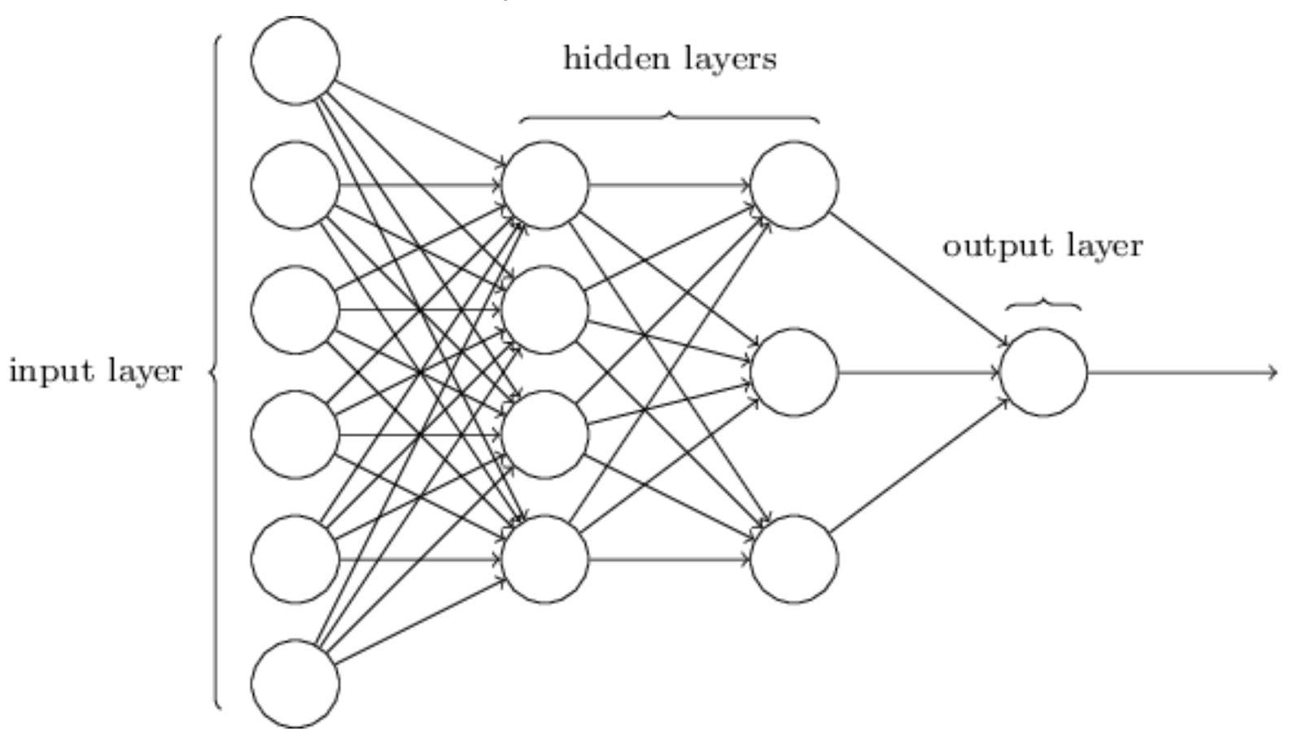
A Quick Review of DNNs
Is this the best idea for sequenced data?

Slide 3
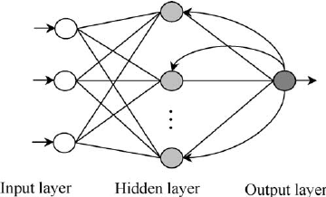
Recurrent Neural Networks (RNN)
An important class of NN architectures, often used for sequence data

Slide 4
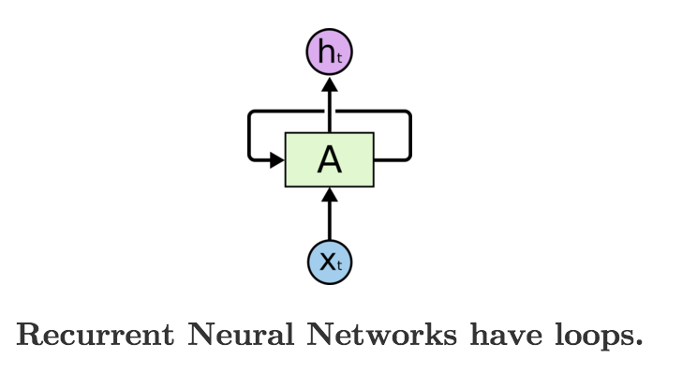
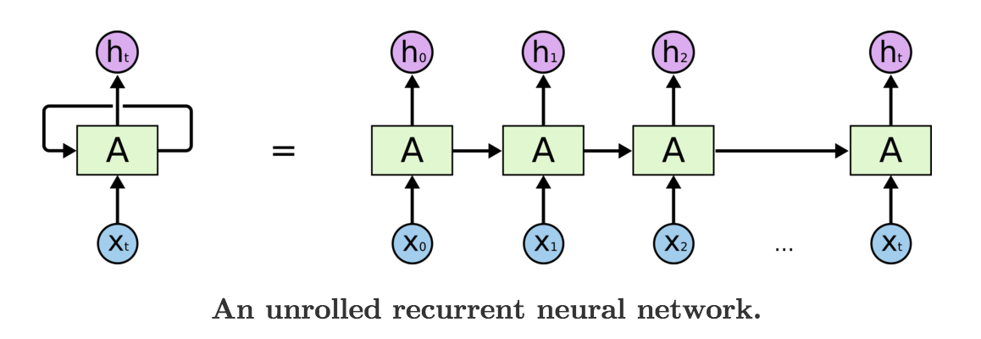
Figures in this presentation are credited to: http://colah.github.io/posts/2015-08-Understanding-LSTMs/

Slide 5
Analysis of RNNs
A natural choice for modeling processing of sequence data in humans.
Hidden states effectively act as a memory for the network.
Suffers from catastrophic forgetting (i.e. vanishing gradient)
This is because we must use Backpropagation Through Time (BPTT)
Difficult to parallelize, thus computationally expensive

Slide 6
Long Short Term Memory (LSTM)
Variation of RNNs developed in the 1990’s
Meant to address catastrophic forgetting
Its most basic unit is the LSTM cell
Information can be stored, written, or read from cell
The cell must decide what should be kept and what can be forgotten
“This is one of the central challenges to machine learning and AI, since algorithms are frequently confronted by environments where reward signals are sparse and delayed, such as life itself.”
https://pathmind.com/wiki/lstm

Slide 7
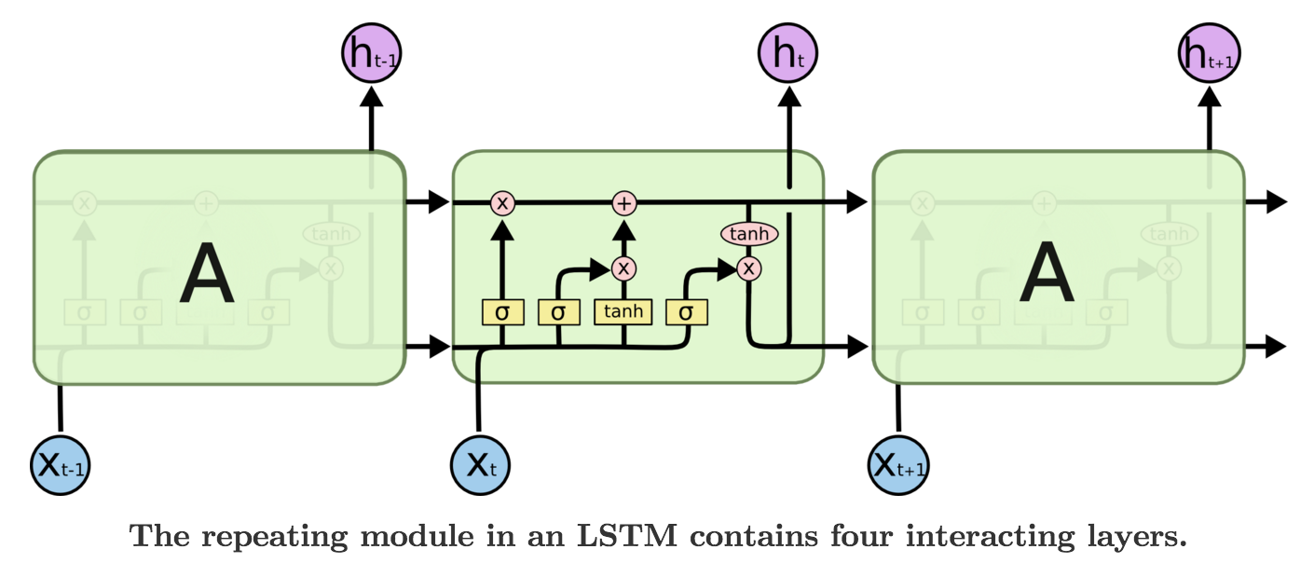
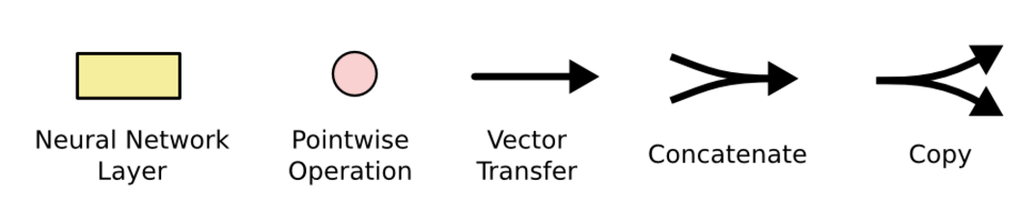
Long Short Term Memory (LSTM)

Slide 8
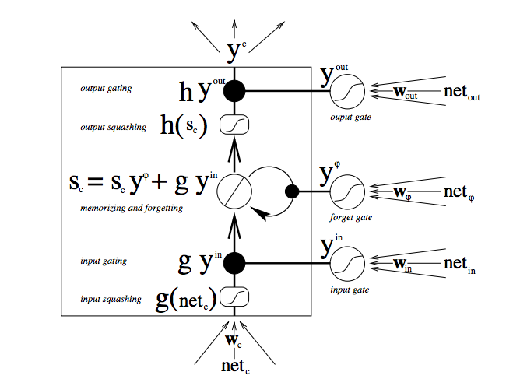
A Closer Look

Slide 9
Why this works
Every single function here is differentiable, meaning we can apply backpropagation
This means that the network can learn over time, without human configuration, when to keep the cell state

